Slide 1
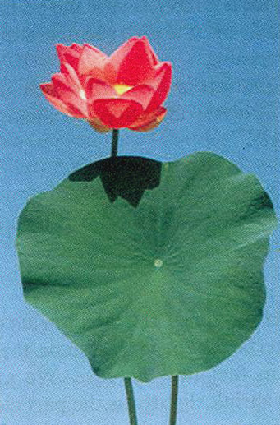
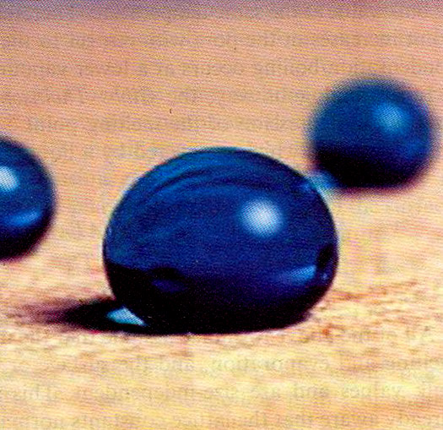
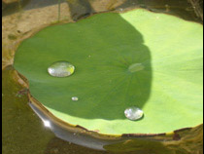
Lotus effect
Synthetic material
showing lotus effect
Non-wetting and
self cleaning surface

Slide 2
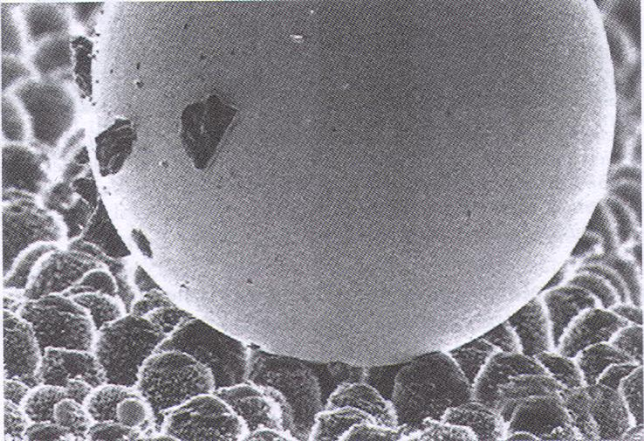
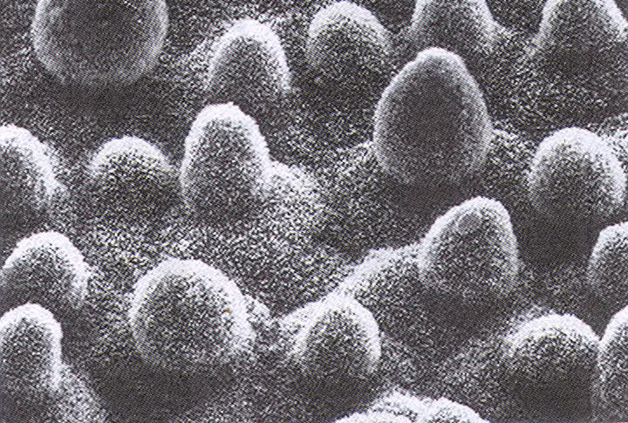
Fakir Bed
Tiny nano-sized structures protrude; Fakir bed type of situation
Water drop on leaf surface.
Dust particles sticking to water drop; self-cleaning

Slide 3
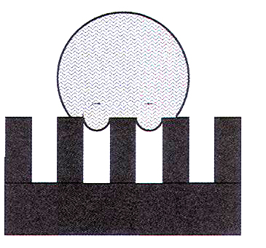
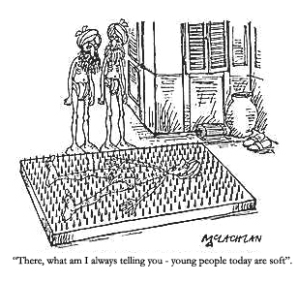
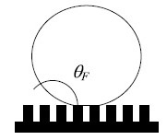
Fakir Bed

Slide 4
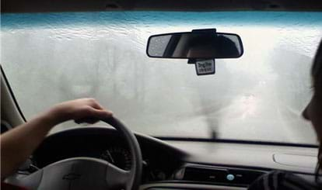
Wetting property and Contact Angle
Consider situations of inside and outside.
Inside – hydrophilic coating (anti-fog coating)
Outside – hydrophobic coating

Slide 5
Wetting property and Contact Angle
Let’s do it.
Take a newspaper sheet and a glass piece. Pour one drop of water on each of these. What do you observe?

Slide 6
Wetting property and Contact Angle
How do we define wetting or non-wetting surfaces, then?
Recall from your high school physics:
Meniscus
Capillary action
Surface Tension
When I keep water (or liquid) in a beaker, there are 3 forces observed:
surface tensions between three sets of surfaces – solid and vapour, solid and liquid and liquid and vapour.

Slide 7
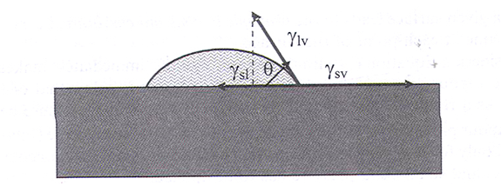
Wetting property and Contact Angle
The mathematical description of this phenomenon is known as Young’s equation given by:
γ_{sv} = γ_{sl} + γ_{lv} cosθ,
where γ_{sv} is the surface tension between solid and vapour and so on.
What is θ here?

Slide 8
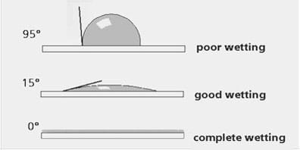
Wetting property and Contact Angle
Systems with
90⁰ < θ ≤ 180⁰ are called non-wetting,
those with 0⁰ < θ ≤ 90⁰ are wetting and
θ = 0⁰ form a spreading liquid film.

Slide 9
Wetting property and Contact Angle
In case of newspaper sheet, the contact angle θ is acute (< 90⁰) and hence it wets the paper. Whereas on glass piece, θ > 90⁰, therefore drop stays on the surface.
The remarkable self-cleaning ability of lotus leaf was not well understood till recently. On a scanning electron microscope imaging

Slide 10
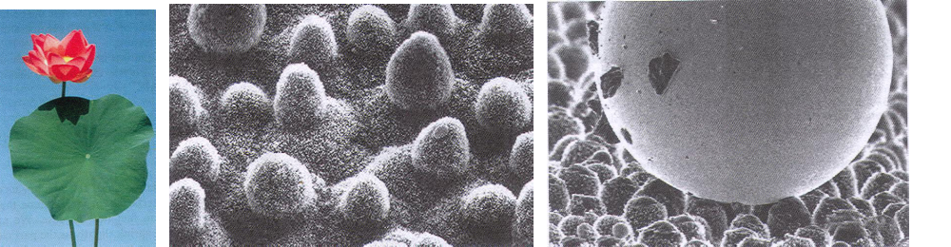
Wetting property and Contact Angle
The contact angle θ is > 150⁰, therefore drop stays on the surface.

Slide 11

Let’s become Spiderman

Slide 12

Peter Parker is not a child’s play!

Slide 13
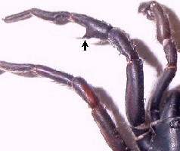
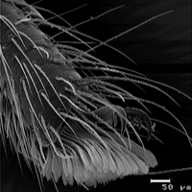
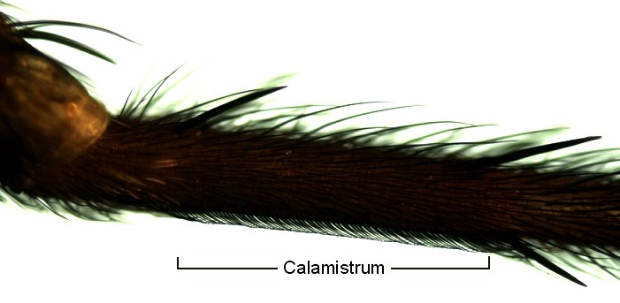
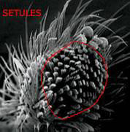

Setules
Setae
Scopula

Slide 14
1 Scopula (area) = 37,000 μm² = 0.037 mm²
78,000 setules in one foot (~ 200 nm wide)
Surface area of each setule ~ 0.17 μm²
Total surface area available (all 8 feet) ~ 0.1x10⁻⁶ m²
van der Waals force (attractive) exerted by one setule ~ 41 nN
Total van der Waals force = 24x10⁻³ N
To overcome its body weight of 15 mg = 15x10⁻⁶ kg
Downward pulling force ~ 0.15x10⁻³ N
Safety factor = 160

Slide 15
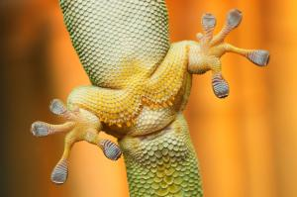
Gecko Feet

Slide 16
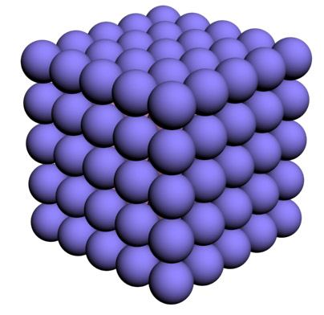
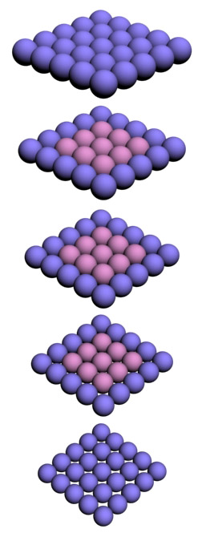
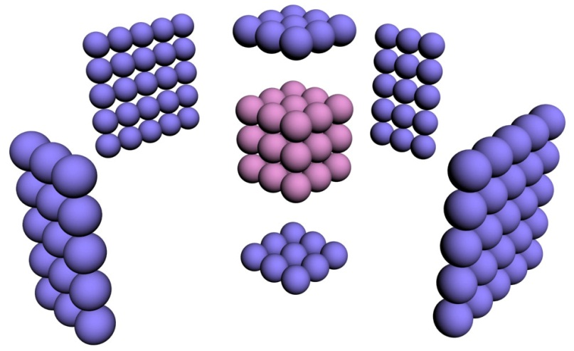
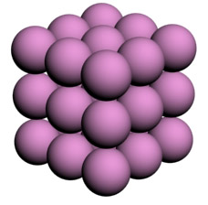
Faces are key to behaviour

Slide 17
Considering Hydrogen atom (radius = 0.05 nm)
n (atoms on edge) | N = n³ (total atoms) | % atoms on surface | Size of cube
10⁷ | 10²¹ | 0.00006 | 1 mm
10⁴ | 10¹² | 0.06 | 1 μm
500 | 125x10⁶ | 1.2 | 50 nm
100 | 10⁶ | 5.8 | 10 nm
10 | 10³ | 50 | 1 nm
5 | 125 | 80 | 0.5 nm

Slide 18
Exploring Nano:
a Pedagogical Journey

Slide 19
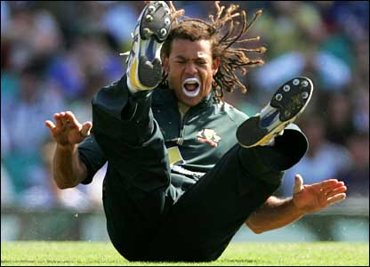

Sunscreen Lotion
Titanium oxide
Zinc oxide

Slide 20
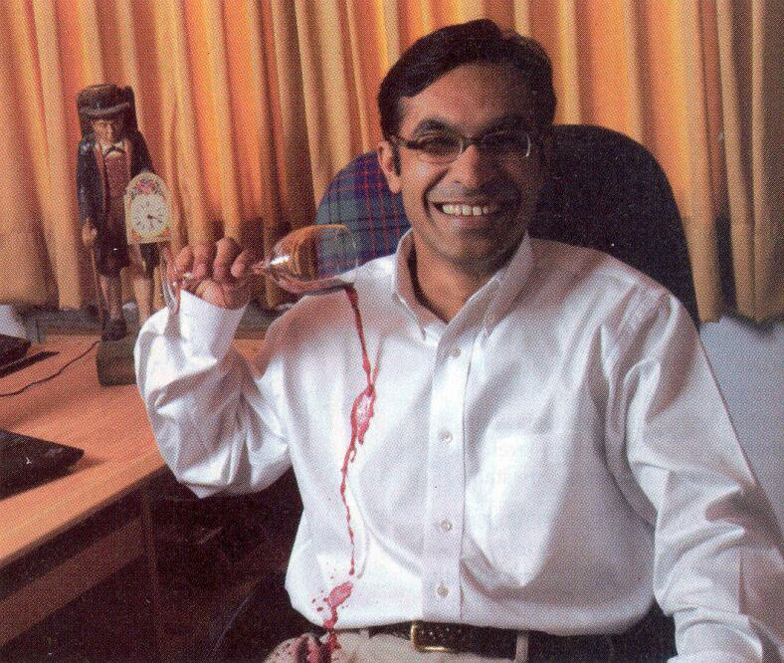
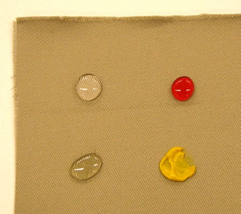
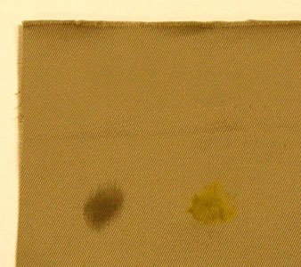
Stain free,
Water resistant fabric

Slide 21
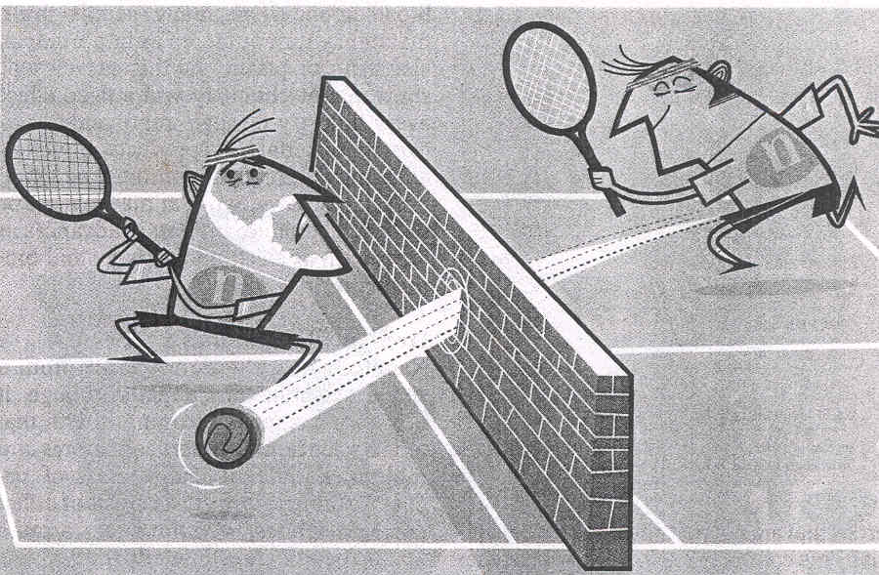
Expect the Unexpected

Slide 22
What is Nanotechnology?

Slide 23
Understanding Effects
Centimeter: Gravity, friction, combustion
Millimeter: Gravity, friction, combustion, electrostatic
Micrometer: Electrostatic, van der Walls, Brownian
Nanometer: Electrostatic, van der Walls, Brownian, Quantum
Angstrom: Quantum mechanics
(1/10,000,000,000 meter)

Slide 24
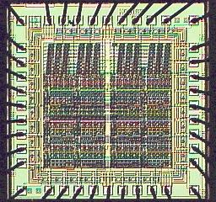
Nanotechnology is all about
Arranging Atoms
Do you recognize this structure?
Diversity
Precision
Cost

Slide 25
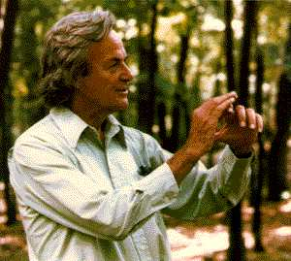
Richard Feynman,1959
(the great visionary)
There’s plenty of room
at the bottom

Slide 26
The principles of Physics, as far as I can see, do not speak against the possibility of maneuvering things atom by atom.
Richard P. Feynman

Slide 27
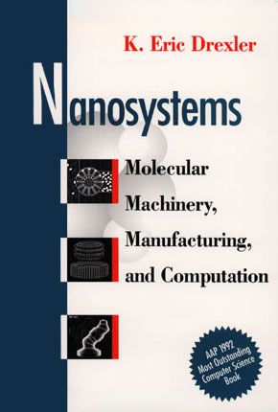
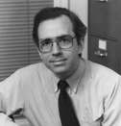
Eric Drexler, 1992
(the great pioneer)

Slide 28
Nanotechnology is the principle of atom manipulation atom by atom, through control of the structure of matter at the molecular level. It entails the ability to build molecular systems with atom-by-atom precision, yielding a variety of nanomachines.
Eric Drexler

Slide 29
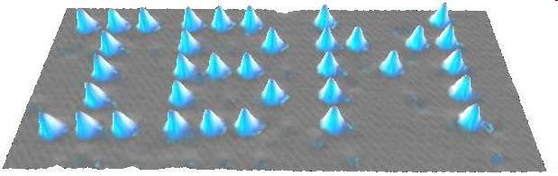
Manipulation Atom-by-Atom
IBM
35 Xe atoms put together
Don Eigler (IBM, California), 1989
Became the 1st person to move atoms

Slide 30
Nanotechnology is concerned with developing the tools for characterizing and manipulating materials on nanoscale (1-100 nm) and exploiting these tools for the development of new products and processes.

Slide 31
Narrow definition: at least 2 dim are below 100 nm
Extended definition: one dimension below 100 nm and a second dimension below 1 μm.

Slide 32
Nanostructure
Based on their geometrical dimension with reference to an external reference system, viz., substrate.
Nanodevice
At least one functional component is a nanostructure.
Nanosystem
Consists of several nanodevices that are of importance for the functioning of the whole system.

Slide 33

Advantages of
starting from “small things”
you can dissolve sugar or salt quicker when it is in powder form and slower when it is in the form of crystals or blocks
smaller can become more reactive

Slide 34
Advantages of
starting from “small things”
Properties can be altered as desired
More precision
Less waste

